Slide 1

G H Raisoni College of Engineering, Nagpur
Date : 31th July 2021
Department of Computer Science and Engineering
Project Phase –I Title Finalization Seminar
Winter 2021 (Session: 2021-2022)
Title of the Project:- Sign Language Translator Using Machine Learning Approach
Guided By: Miss Neha Purohit
Presented By:
Sushank Dambare(C-18)
Yash Mohare (B-70)
Amey Surkar( A-28)
Presented to:-
Atiya Khan
Assistance Professor
GHRCE ,Nagpur

Slide 2
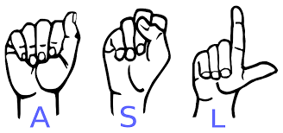
Introduction
Sign language is a visual language initially used by people who are aurally impaired by making gestures with hand and facial expressions.
Sign language interpreters facilitate communication between people who are deaf or hard of hearing and people who can hear.
Our system aims to get the deaf and dumb people more involved to communicate and the idea of a camera-based sign language recognition system that would be in use for converting sign language gestures to text /speech.

Slide 3
Abstract
Sign language translation (SLT) is an important application to bridge the communication gap between deaf and hearing people
Sign Language (SL) is a subset of gestures or signs made with fingers, hands, arms, eyes, and head, face etc.
The proposed system tries to do a real time translation of hand gestures into equivalent English text and speech. This system takes hand gestures as input through video and translates it text and speech which could be understood by a non-signer.
We are going to come up with real time method using neural networks for finger spelling the sign language.

Slide 4
Objectives
The main objective is to translate sign language to text / speech.
The framework provides a helping-hand for speech-impaired to communicate with the rest of the world using sign language.
This leads to the elimination of the middle person who generally acts as a medium of translation.
The aim is to develop user friendly vision based interface where the computer understand the sign language and translate it to the needed people.

Slide 5
Literature Survey (Survey of existing products)
1] SLAIT . sign language translator with AI
Sign to Text & speech to text
Startup -learning platform
Artificial intelligence inside
2] Sign Language Translator -funtranslation(Web)
only text to sign
web application
simple user interface
3] lingojam.com /Sign Language Translator(Web)
only text to sign
web
simple UI
4] Text to Sign Language (ASL)Converter
only text to sign
web - Design part
simple UI

Slide 6
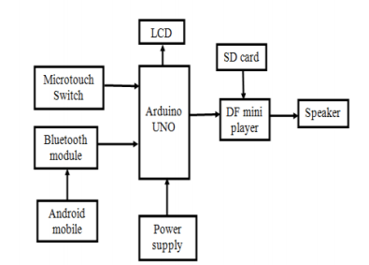
On the basis litrecher survey done by us we came on the conclusion that the following approaches and technology are used by this interesting products.
5] SIGN LANGUAGE TRANSLATOR USING MACHINE LEARNING
Extraction of gesture
Creating data set
6] Design And Implementation Of Sign Language Translator Using Micro Touch Sensor.

Slide 7
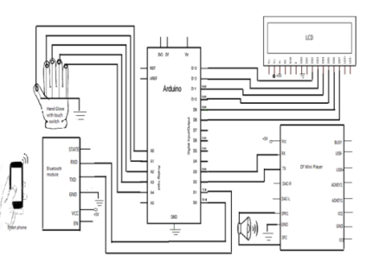
The system has micro touch sensor switch for detecting the hand gestures of the subject. These sensor values are stored on the arduino unit.
Based on the hand motions the stored outputs are displayed in the LCD and also played through the speaker.
Embedded C language is used to write the arduino program.
In this system the hand motions are detected in few seconds,the user forms a sign and holds it for two seconds to ensure recognition. The system is capable of reducing the time limit for translation.

Slide 8
Proposed Methodology/System Architecture
This is vision based computer system which determines the gestures of bare hand and translates it into text and speech without use of any external devices.
This system will use Artificial Neural Networks and Convolution Neural Network to be implemented for processing and recognizing patterns to give the desired output.
Architecture
Data Collection
Preprocessing
Training By using Deep Learning Techniques
GUI-Prediction

Slide 9
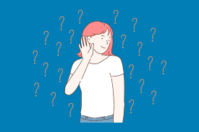
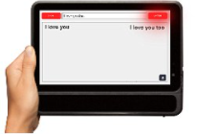

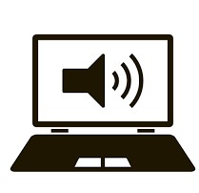
The system specification with respect to the person (Deaf & Dumb).
Deaf person
They read from screen which our system provide in text/speech form .
Dumb person
They are able to read and hear also from screen .(text/speech )

Slide 10
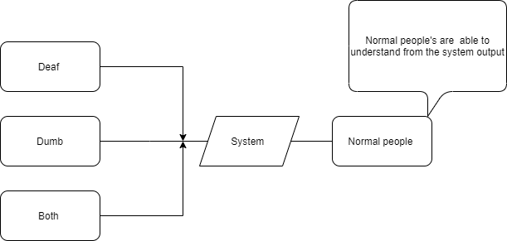

Slide 11
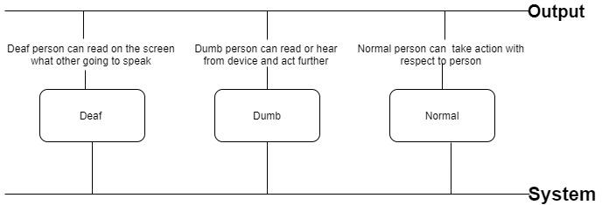
System -output scale

Slide 12
Hardware / Software Specification
Hardware Specification:
Web-Camera
Laptop/Computer System
Software Specification:
Python Setup
Tensor flow
OpenCV (Computer Vision)
Microsoft Visual Studio Code
Neural Networks

Slide 13
Conclusion
The requirement of machine-based sign language translator is very important in the present scenario. Even though we have found initial success in this regard, lot of work needs to be done.
The main area where this can be used is in public places like ticket issuing counters, hospitals etc.
This can be even used to teach the sign language to normal people.
Further this can be used to take words and display the gesture for the same.
Recognizing fingers will widen the training set for the machine.

Slide 14
References
[9] N. Mukai, N. Harada and Y. Chang, "Japanese FingerspellingRecognition Based on Classification Tree and Machine Learning," 2017Nicograph International (NicoInt) , Kyoto, Japan, 2017, pp. 19-24.doi:10.1109/NICOInt.2017.92).
Byeongkeun Kang , Subarna Tripathi , Truong Q. Nguyen ”Real-timesign language fingerspelling recognition using convolutional neuralnetworks from depth map” 2015 3rd IAPR Asian Conference on PatternRecognition (ACPR).
medium.com/@tharanignanasegaram/artificial-neural-network-a-brief-introduction-572d462666f1.

Slide 15
Thank You…..

